Slide 2
Introduction & Motivation
Online Marketplaces are becoming increasingly popular
eBay has over 62million users per month
Large data volume & data generation velocity
Fraud has become common through botting
Scalping, Scamming, etc.
Users become dissatisfied
Cat & Mouse for detecting fraud

Slide 3
Literature Review
Assafi et al [1]
Machine learning is not computationally compatible for large or complex datasets
Mittal & Sangwan [2]
Pipeline for divide & conquering large datasets
Large datasets are too computationally expensive
L’Heureux et al [3]
Survey of challenges and solutions of problems within big data dimensions (Volume, Velocity, Variety, Veracity)
Wang & Alexander [4]
Exploration of scale-up through ML Algorithms
Decision Trees were fast and good at handling various feature types
Ahmed, Younis, and Ali [5]
Propose a big data classification framework similar in nature to ours
Decision Trees & Random Forest were accurate
Notes:
Assafi = comparison of big data techniques exploring accuracy vs speed
Mittal = large datasets are difficult to store and transfer – needs work arounds
Wang = Decision trees were fast, somewhat accurate, and good at handling discrete and continuous features
Ahmed = RF and DT were some of the best models by all accuracy metrics

Slide 4
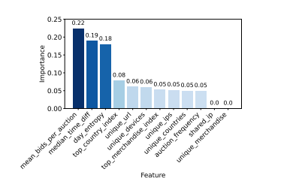
Feature Importances & Selection
Importance is not identical to correlation
Disparity caused by ML model
Feature Importance Hierarchy:
1) Behaviour Frequency
2) Suspicion of Masking
3) User Interests
Feature Selection through Importance
Manual Feature Selection

